Slide 1
A Survey of Digital Modes
9/22/2018

Slide 2
Digital Mode Agenda
Introductions
Why Digital?
Equipment requirements
Tools of the Trade
Software
Propagation Websites (Wsprnet.com, pskreporter.info)
Logging (Logbook of the World, eQSL, QRZ.com)
Type
Unstructured
Fuzzy
Structured
Networking
Bandwidth
Prevalence
Examples of Modes
NBEMS Discussion

Slide 3
Introductions
Aaron Jones – AG7GK first licensed in 2016 as KI7DUK
Go around the room:
Name and Callsign
License level
Any goals you care to share in relation to Digital Modes
Experience with Digital Modes
APRS
NBEMS (FLDIGI)
WINLINK
DX MODES

Slide 4
Why Digital?
CASE FOR DIGITAL EMCOMM
Voice example using NTS Traffic Protocols:
St. John's, prepare to copy.
Tag 176003, female, 20 - 30, transport helo, red.
Now imagine having to transmit and verify that 20, 30, 50 times or more.
How long would that take?
Not including phonetics, repeats, fills, breaks, and confirmation...
17 minutes.
Using a digital mode, we can transmit that data in a fraction of the time... and verify it!
2 minutes 28 seconds.
Maybe you just don’t feel like talking to someone!

Slide 5
Notes:
Many locations any licensee can play with digital modes

Slide 6
Equipment
Computer OR Tablet / Phone
Cables
Radio with APRS
GPS
RADIO
TNC or Soundcard
Pactor Modem (In case of Network modes like Winlink)

Slide 7
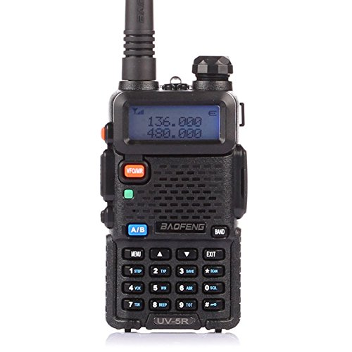
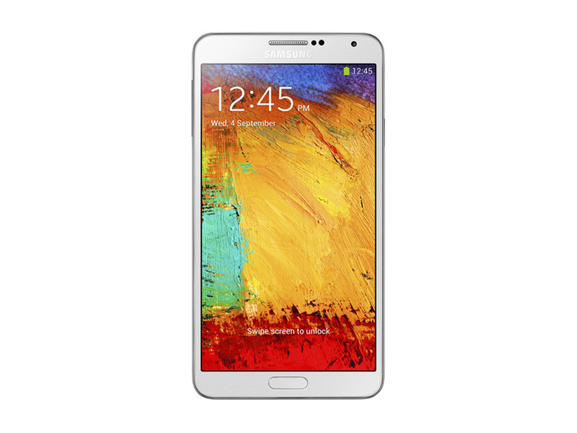
HT Acoustical Coupling
Tablet / Phone / Computer
Apps:
Android SSTV
AndFLMSG
Droid PSK
HT with HT specific cables
Baofeng HT
APRS Specific Setup
HT
MOBILINK TNC and Cable
APRS Droid

Slide 8
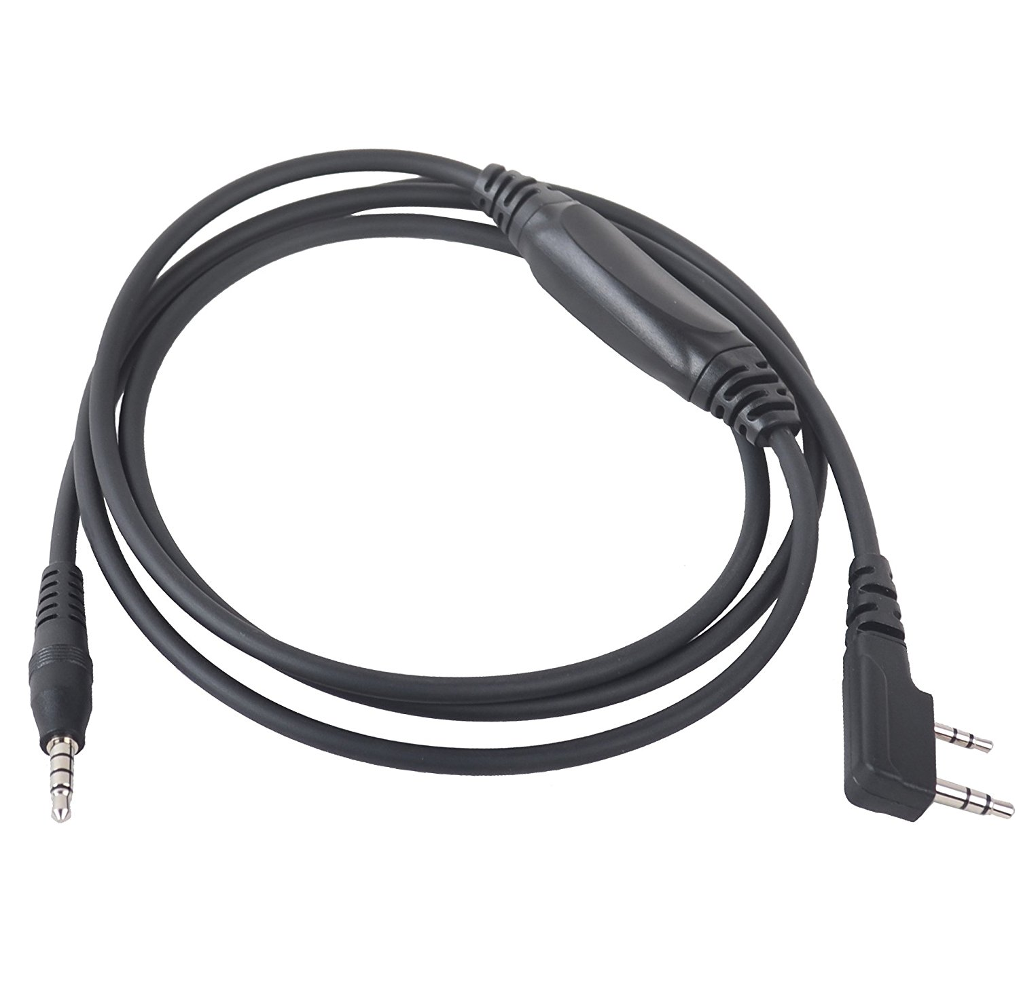
HT / Audio Cable
Tablet / Phone / Computer
Apps:
Android SSTV
AndFLMSG
Droid PSK
HT with HT specific cables
Baofeng HT
Baofeng BT Tech APRS Cable using VOX PTT OR
Custom Audio interface cable to trigger PTT
APRS Specific Setup
HT
MOBILINK TNC and Cable
APRS Droid

Slide 9
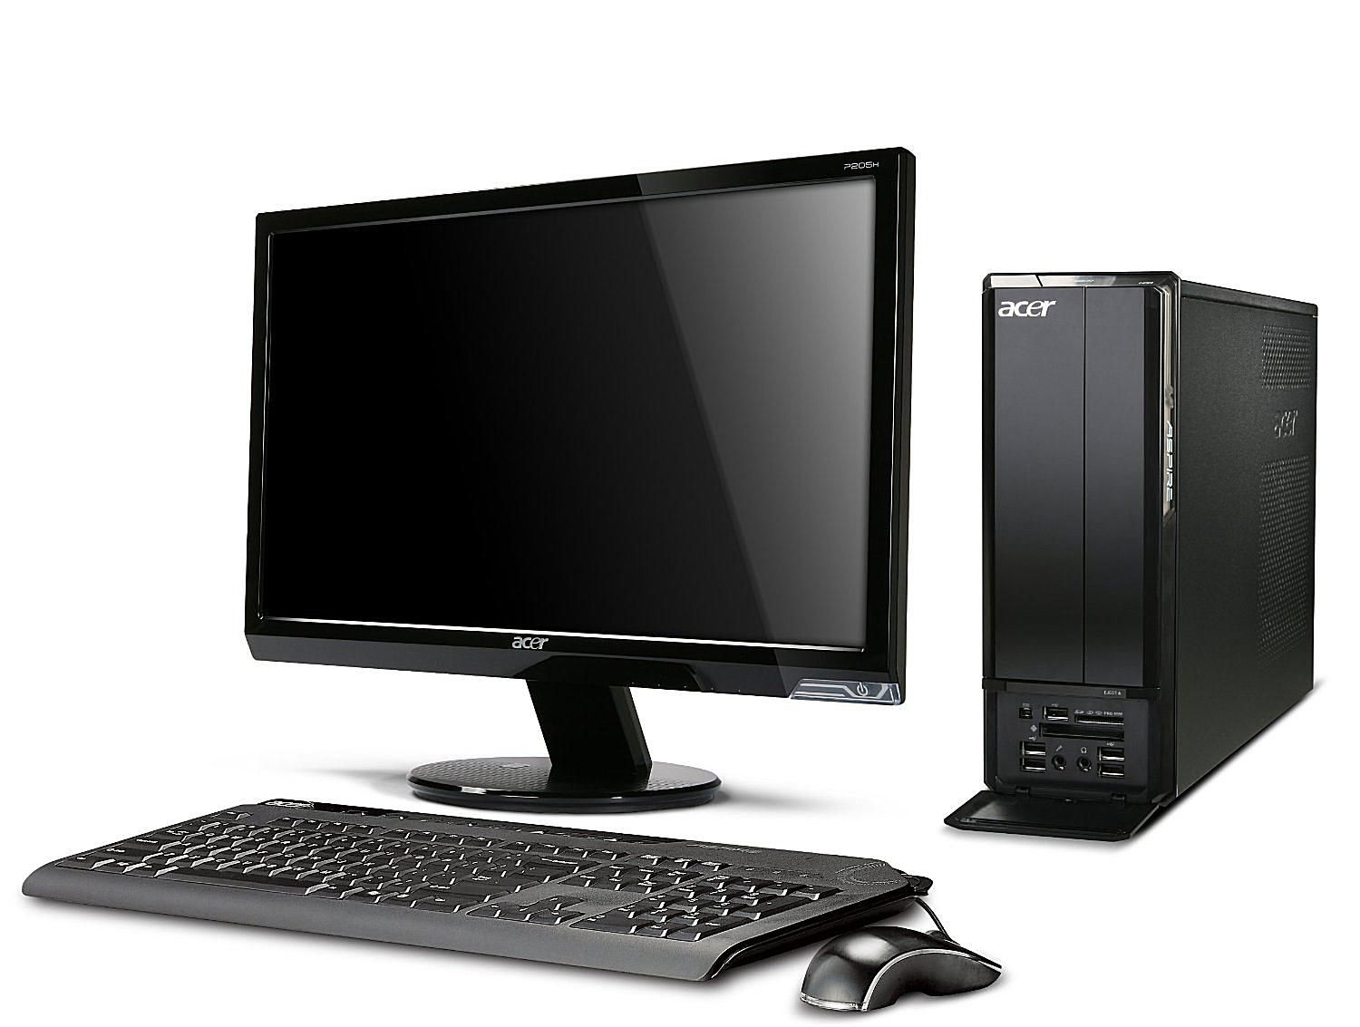
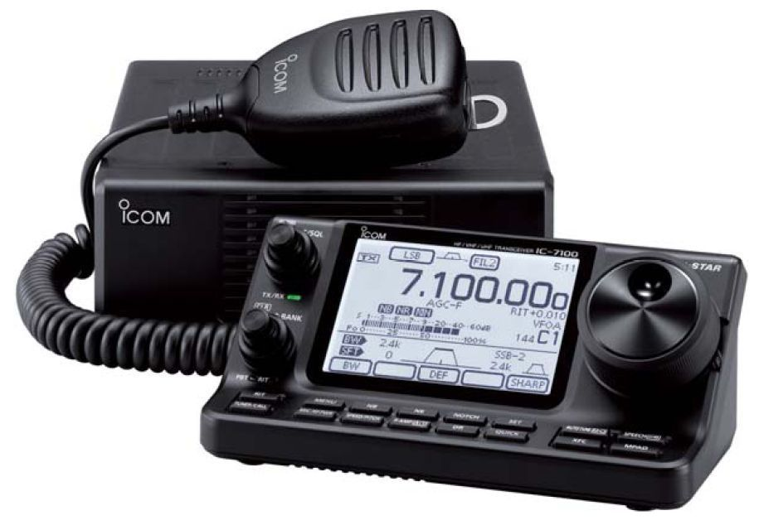
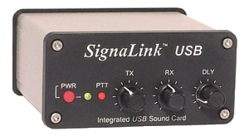
Basestation
Computer / Tablet
Soundcard either built in or USB
Apps:
MMSSTV
FLDIGI- FLMSG-FLRIG
WSJTX
WSJT-X JTalertX
Bastation
Any Antenna – Mag Loop, Dipole, Vertical, anything to get a signal in and out

Slide 10
Warning about Duty Cycle
Reduce your power!
Unlike SSB, these modes either run at 100% duty cycle, or use multiple tones sensitive to intermodulation distortion!
Be kind to your finals!
Keep peak power out well below key-down CW maximum to minimize distortion.
Keep ALC to zero
Turn off speech processing or compression

Slide 11
Software
WSJTX – used for FT8, JT Modes, WSPR, and Meteor Scatter
MMSSTV – Used for Slow Scan TV
FLDIGI – Many modes and options with companion software such as:
FLAMP - Amateur Multicast Protocol (One to Many Transmission of Files)
FLMSG – Message sending, one to many including CSV data, Text, Images, Radiograms, and many ICS related Emcomm forms
ANDFLMSG – Android version of FLMSG
Other FL related software
Winlink RMS Express
APRS Software (Many versions for all platforms)

Slide 12
Propagation Websites
PSKreporter.info: https://pskreporter.info/pskmap.html
Use the stats page to see what modes are happening: https://pskreporter.info/cgi-bin/pskstats.pl
Wsprnet for WSPR results; http://wsprnet.org/drupal/wsprnet/map OR alternative: http://wspr.aprsinfo.com/
Hamspots.net: https://hamspots.net/
APRS.fi: https://aprs.fi
Online listing of hosted SDR receivers, great for verifying your signal on voice OR digital: http://websdr.org/

Slide 13
Logging
The reasons for logging your amateur activity fall into three categories: legal, operational and personal.
Legal – proof if someone complains of interference or similar issues(out of band operations)
Operational – DX’ing and QSL’s
Personal – Who you’ve contacted, when, where, antenna, power, distance etc. Next time you want to try that mode again, you can go back to the frequency you had success on as evidenced by your log
Logging Programs: Online, or PC based
DX Logging:
ARRL LOTW: https://lotw.arrl.org/lotwuser/default
eQSL.net
QRZ.com (also used for looking up hams, a must have if you are DX’ing)

Slide 14
Bandwidth
Note: Not “necessary bandwidth” as defined by ITU
Notes:
Not “necessary bandwidth”

Slide 15
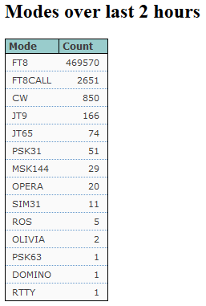
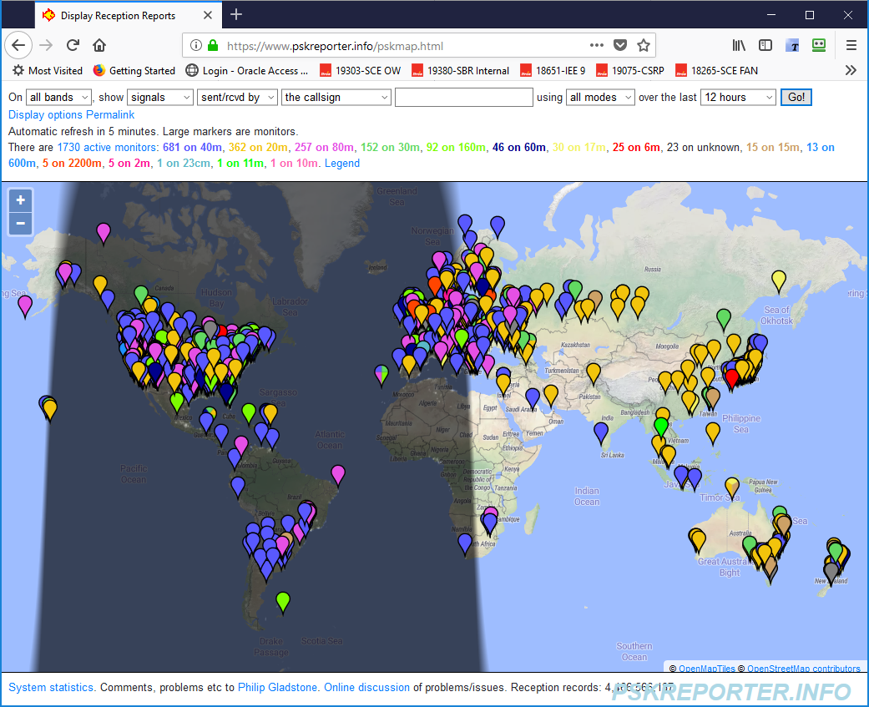
Digital DX Mode Prevalence
Note: APRS and Winlink are not reported here

Slide 16
Digital Modes
Unstructured:
CW
PSK AND VARIANTS
OLIVIA
MFSK
MT63
Fuzzy Modes:
RTTY
HELLSCHREIBER
SSTV
Structured Modes:
JTMODES (JT65, JT9, FT8, FT8CALL), WSPR
Network Modes:
Winlink
APRS

Slide 17
Mode Definitions
Unstructured: generally considered “sound card modes” for keyboard-to-keyboard communications. Because each of these modes is optimized for a specific purpose by blending multiple features, they often defy simple categorization. No specific timing sequences, though data is timed with specific frequency or audio shifts and durations.
Fuzzy Modes: Machine generated and decoded, they are designed to be human-read. These output a visual representation of the data.
Structured Modes: more “Structured data”. This provides more robust data connections and better weak signal performance or more sophisticated data. Each of these modes bundles data into packets or blocks that can be transmitted and error checked at the receive end.
Network Modes: operate using features and functions associated with computer-to-computer networking.

Slide 18
CW
Origin: Samuel Morse, 1830’s-1840’s, sending electrical pulses over wire
Bandwidth: 50-100 hz
Prevalence: Used extensively for contesting, worldwide communications
Complexity: Manual, human managed, computer based CW is unpredictable for deciphering/decoding
Equipment requirements: Keyer, Radio, and Fluency

Slide 19
RTTY
Origin: 1910 Electrical impulses for each key on a typewriter, shifted to wireless
Bandwidth: 250 hz
Prevalence: For contests lately
Complexity: Computer based FLDIGI software or similar
Equipment requirements: Computer, Soundcard, Radio
To send teletype signals on the air, the transmitter generates a continuous carrier that is shifted slightly between two different frequencies that correspond to the mark or space states. This technique is known as "frequency shift keying" or FSK

Slide 20
HELLSCHREIBER
Facsimile-based mode developed by Rudolph Hell in 1929
Text is transmitted by dividing each column into seven pixels and transmitting them sequentially starting at the lowest pixel. Black pixels are transmitted as a signal and white as silence at 122.5 bit/s (about a 35 WPM text rate). Pixels sent TWICE
Text will appear as two identical rows

Slide 21
HELLSCHREIBER
Notes:
First HELL QSO

Slide 22
SSTV
A single image is converted to individual scanned lines and those lines sent as variable tones between 1500 and 2300 Hz
A color image takes about 2 minutes to transmit, depending on mode. Some black and white modes can transmit an image in under 10 seconds
Uses for Emcomm? Pictures of flooding, storms, damage, wellness checks, documentation.
Many options for PC, MAC, Linux, Android and IOS software

Slide 23
SSTV
SSTV Software “MMSSTV”
Captured on 145.500 Mhz VHF from International Space Station from Russian Cosmonauts celebrating 40 years in space
Fun mode for sending pictures and various software options for computer, Android, and IOS
Notes:
SSTV Image from International Space Station transmitted by Kosmonauts

Slide 24
PSK AND VARIANTS - Demo
Developed in 1990’s as computers became ubiquitous and digital signal processing improved
PSK stands for Phase Shift Keying. In the context of amateur radio, it describes a family of operating modes (each of which has a slight variation in the signaling parameters) that are used for on-the-air keyboard-to-keyboard contacts.
Peter Martinez (G3PLX) established signaling parameters (bit rates, coding schemes, etc.) and called his product PSK31
DEMO FLDIGI Single and Multi-PSK

Slide 25
OLIVIA
Developed in 2003
Olivia is a ham radio digital mode designed to work in difficult (low s/n ratios plus multipath propagation) conditions on HF bands (though it also works as well on VHF/UHF).
Olivia has many formats some of which are considered standard and they all have different characteristics. The formats vary in bandwidth (125,250,500,1000, and 2000hz) and number of tones used (2,4,8,16,32,64,128, or 256). This makes it possible to have 40 different Olivia formats which have different characteristics, speeds, and capabilities. Luckily only a relatively few are commonly used.
Most common modes: 500/8, 500/16, 250/8, 1000/32, and 1000/16
http://www.oliviamode.com/
Notes:
If you, for instance, were talking to me on 500/16 Olivia format and we both had very strong signals and not much QRM, QRN, etc. then ask me if I would like to go to 500/8 format or even 500/4 format. 500/16 format is approximately 20wpm while 500/8 is close to 30wpm and 500/4 close to 40wpm. If you do end up switching to the faster modes you may also want to increase your Sync Integration Period setting substantially too - to maintain the best quality decoding. If not, you might get more errors in the decoded text. And if the band conditions become worse - go back to the original format AND remember to reset your Sync Integration Period setting or the delay in decoding will be way too long! Also, if the band starts getting real crowded and say, for example, you were on 500/16 mode - you might suggest to the other station to switch to 250/4 mode (increase Sync Integration Period setting too) to save space and be a "good neighbor" to all the other operators nearby. 250/4 is the SAME speed as 500/16 and nearly as sensitive with the correct settings.

Slide 26
JT Modes (JT65, JT9, FT8)
Origin: Created by Joe Taylor W1JT in 2003 for EME work
A way to have a QSO using a computer
A weak signal digital communications mode for Amateur Radio
A Multi-Frequency Shift Keying scheme employing Forward Error Correction with 65 tones
Bandwidth: 50-180 hz
Prevalence: Predominant modes for DX contacts
Equipment requirements: HF Radio, Soundcard(ext/int), Computer, Rpi can work, WS-JTX software, other options exist
Pros: Widespread, with FT8 very fast QSO’s, SNR resilience
Cons: Not conversational

Slide 27
JT Modes (JT65, JT9, FT8)
Exchange with TAIWAN
30 Meters
Very weak signal, BV1EK reported my signal at -18 SNR and I reported his at -14

Slide 28
FT8CALL New Software
New software being built TODAY
Uses FT8 Protocol but allows keyboard to Keyboard Conversational Style
Integrated with APRS to allow location updates and EMAIL-2 directed messages
Getting Popular but get ready to WAIT, very slow.

Slide 29
6M HVF MSK144 Meteor Scatter
As meteors are vaporized in the upper atmosphere, they leave behind ionized trails at heights of 60 – 70 miles that are sufficiently dense to reflect radio waves in the HF and VHF range.
A long trail lasts only 15 seconds – most trails are less than 1 second long

Slide 30
WSPR (Demo)
Origin: 2008 by Joe Taylor
The Weak Signal Propagation Reporter
An automated system designed for sending and receiving low-power transmissions to test propagation paths on the MF and HF bands.
The program can decode signals with S/N as low as -28 dB
Bandwidth: 6 hz
Antenna propagation at: http://wsprnet.org/drupal/wsprnet/map OR http://wspr.aprsinfo.com/
Equipment requirements: HF Radio, Soundcard(ext/int), Computer, Rpi can work, WS-JTX software, other options exist
Pros: Great for seeing where your signal is going
“WSPR is about 11 dB better than ear-and-brain CW.
“For most operators, the difference is more like 15 dB."

Slide 31
WSPR (Demo)

Slide 32
Digital “Systems”
APRS
VHF 144.39 MHz simplex
Utilizes “Digipeaters”
Requires TNC or software (Many options)
Good for short text messages
Map/ Location awareness
Winlink
VHF 145.01 MHz simplex and certain HF
Utilizes RMS packet and HF pactor stations
Requires TNC or software (RMS Express)
Email and File attachments
NBEMS/FLDIGI
Can utilize any VHF/UHF simplex freq, repeaters, HF
Can use “acoustic coupling” for interface but hardwired interfaces more reliable
Good for text messages, forms, files

Slide 33
Operational Flexibility

Slide 34
Winlink
Worldwide system for sending e-mail via radio
Provides e-mail from almost anywhere in the world.
Adopted for contingency communication by many government agencies
Used by infrastructure-critical NGOs such as International & American Red Cross, Southern Baptist Disaster Relief, DHS Tiered AT&T Disaster Response & Recovery, FedEx, Bridgestone Emergency Response Team, etc.
VHF and HF options
Hardware: Computer, TNC or Pactor Modem, RMS Express Software, Radio
Pros: Pactor is very fast for HF, reliable, has peer-to-peer options
Cons: Reliant on internet in normal operation, complexity

Slide 35
Winlink

Slide 36
APRS (Demo)
Automatic Packet Reporting System
Original Developed in 1984 to Map Navy Positions, with availability of GIS in the 90’s became feasible for GPS integration
The system is based on the AX25 Packet protocol, and was developed by Bob Bruninga WB4APR, a senior research engineer at the United States Naval Academy.
North American frequency is usually 144.390, though operable at UHF, 6 meters and some HF
Mostly a one-to-many system, though there are some one-to-one applications
Public service and events, search and rescue, emergency services

Slide 37
NBEMS / FL “Suite”
Narrow Band Emergency Messaging System
http://www.w1hkj.com/NBEMS/NBEMS.ppt
Software (All free):
FLDIGI – Main application for mode selection, rig control, QSO’s
FLAMP – Application for sending files in chunks, allows for retries and relays of missing chunks
FLMSG – Your go-to application for sending text and forms (Radiograms)
ANDFLMSG – Android version
FLRIG – Rig control application if you have a CAT control interface to your RIG

Slide 38
NBEMS - Demo
Low Power - never need to run over 50 watts, 5 -30 watts is almost always sufficient
Reliable communications – succeeds even when CW fails some modes work below -8 dB s/n
Many modes - choose your mode depending on conditions
Bottom of the solar cycle - works well, even under very poor conditions where phone QSO’s would be impossible!
Emergency Communications
You already have 99 % of the equipment – nothing expensive to buy
It’s FUN

Slide 39
Useful Websites
Comprehensive Guide to NBEMS / FLDIGI, equipment setup, instructions, etc: http://gblakesl.net/ARES/Basic-NBEMS-Workshop.pdf
Presentation on Winlink: http://www.philsherrod.com/Winlink/Winlink_RMS_Express.pdf
Excellent Presentation on NBEMS and FLDIGI: https://www.jeffreykopcak.com/drive/ham_radio/digital_modes/vhf_uhf_nbems_an_introduction_using_fldigi_and_flmsg_presentations/vhf_uhf_nbems.pdf
Presentation on JT Modes: http://www.informationtechnologies.com.au/files/JT65%20Presentation.pdf
WSPR Presentation: https://www.powershow.com/viewht/1a4552-ZDc1Z/What_is_WSPR_powerpoint_ppt_presentation
Meteor Scatter Introduction: Link

Slide 40
More Useful Websites
APRS: http://www.aprs.org/APRS-mobile.ppt
A PRACTICAL EVALUATION AND COMPARISON OF SOME MODERN DATA MODES: http://www.qsl.net/zl1bpu/MFSK/datmodes2.pdf
ARRL presentations on NBEMS (Narrow Band Emergency Message System) with FLDIGI
http://www.arrl.org/files/file/On%20the%20Air/Tutorials/Introduction_to_NBEMS_ARRL.pdf
http://www.arrl.org/files/file/On%20the%20Air/Tutorials/Advanced_NBEMS_3_0.pdf
http://www.w1hkj.com/NBEMS/NBEMS.ppt
Digital Mode Comparisons from FLDIGI Help files: http://w1hkj.com/FldigiHelp-3.21/Modes/Compare.htm
Signal ID Wiki – listing of all digital signals, explanations, samples:
https://www.sigidwiki.com/wiki

Slide 41
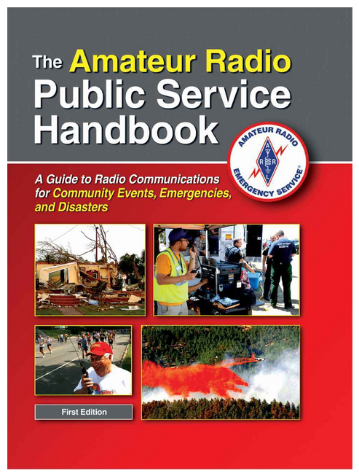
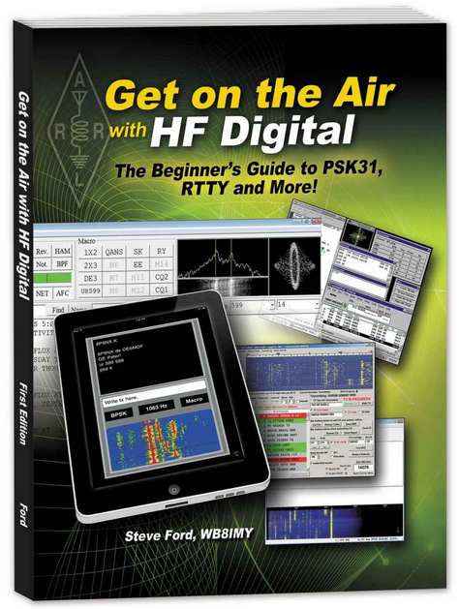
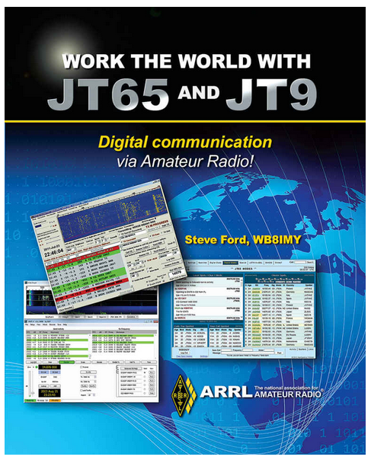
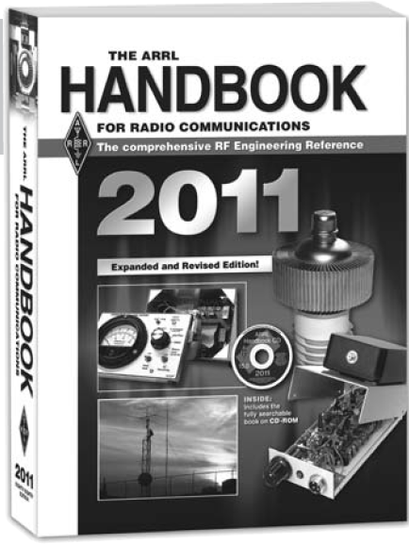
Nerd Reading

